Slide 1
DRIVIOO

Slide 2
Table of content :
01. Our Team
02. The Idea
03. Stage of creation
04. Technologies
05.Our Time Table

Slide 3
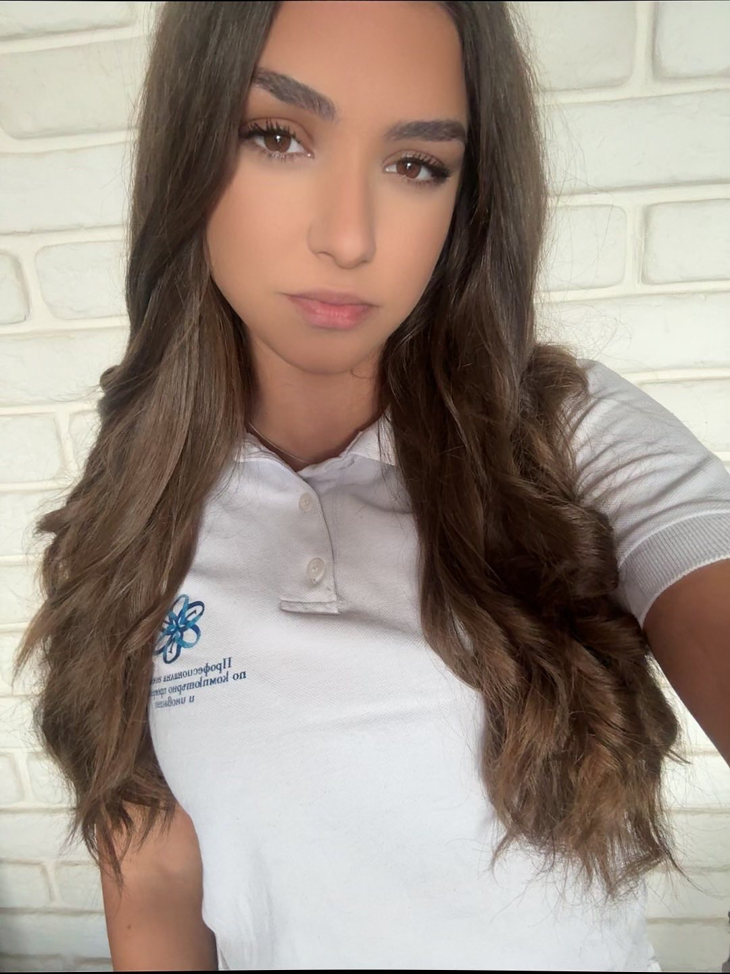
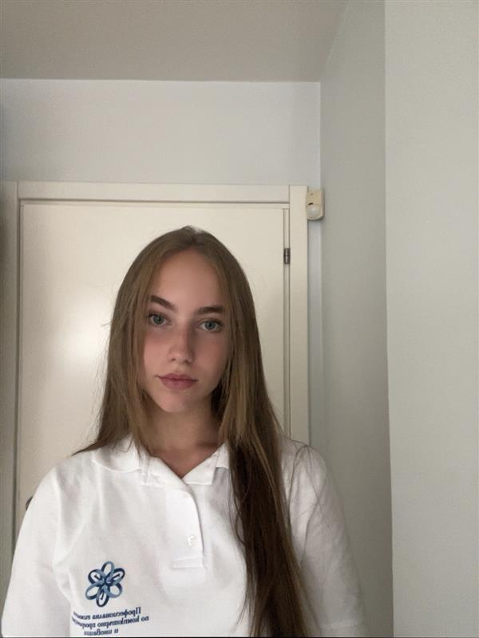
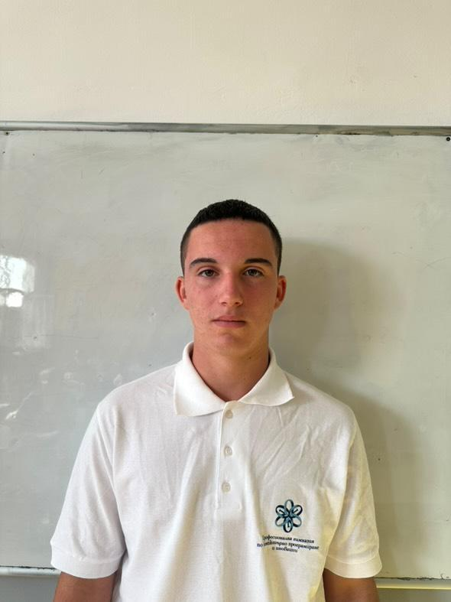
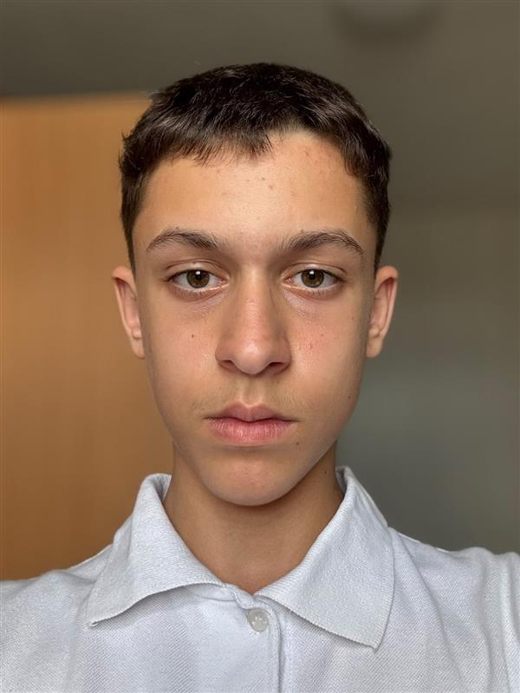
01. Our Team
Maria Pavlova
8a
Designer
Iveta Noneva
8b
Frontend Developer​
Yanko Yanakiev
8v
SCRUM Trainer​
Velin Markov
8g
Backend Developer​

Slide 4
02.The Idea...

Slide 5
03.Stage of creation:
Come up with an idea
Work on the project​
Testing and debugging​

Slide 6









04.Technologies:​

Slide 7


05. Our Time Table
Period: | Monday | Tuesday | Wednesday | Thursday | Friday | Saturday | Sunday
21.04- 27.04
28.04- 04.05
05.05- 11.05

Slide 8
Let’s move into the project!

